Slide 1
BIRTH/DEATH REGISTRATION WITH SERVICES
PIP2001 Capstone Project
Review-1
Batch Number: PSCS201
Under the Supervision of,
Dr. Sukruth Gowda M A
Assistant Professor- Senior Grade
School of Computer Science and Engineering
Presidency University
Roll Number | Student Name
20211CSE0541 20211CSE0536 20211CSE0433 | JOEL G DANIEL SAMIKSHA RAJAN SATHYA SREE E
Name of the Program: B.TECH
Name of the HoD: DR . ASIF MOHAMMED H B
Name of the Program Project Coordinator: Ms. HAJEERA NIKHAT KHANAM
Name of the School Project Coordinators: Dr. Sampath A K / Dr. Abdul Khadar A / Mr. Md Ziaur Rahman

Slide 2
Introduction
This project aims to create an AI-powered system to make it easier to manage and issue birth and death certificates. As public services need to be more efficient, our solution uses artificial intelligence to speed up verification, reduce mistakes, and keep personal data safe.
The system will use smart technology to simplify how people apply for, process, and retrieve their certificates. By providing a user-friendly interface, we want to help citizens access their documents more easily while also easing the workload for government offices.
Overall, this project aims to improve the accuracy and speed of issuing certificates and to build trust in public services, making them better for everyone in the community.

Slide 3
Literature Review
Managing birth and death certificates is vital for public services, but traditional methods can often be slow and prone to mistakes (Varela et al., 2021). In this review, we’ll explore how technology, particularly artificial intelligence (AI), can make these processes better.
Integrating Technology: Using digital platforms can streamline data entry, making it quicker to issue certificates (Ghosh et al., 2020).
Automating with AI: AI can take over tasks like verifying information and processing applications, which helps reduce errors by spotting patterns in data (Alhassan et al., 2022).
Learning from Success: Real-world examples show the benefits of AI. For instance, a project in India cut processing time by 40% using AI technology (Kumar & Sharma, 2020).

Slide 4
Literature Review
Creating User-Friendly Designs: It’s important to design accessible platforms. Involving users in the design process ensures the system meets their needs and encourages adoption (Smith et al., 2023).By leveraging AI and modern technology, we can greatly improve how we manage birth and death certificates. This shift can enhance efficiency, accuracy, and security in public services, benefiting everyone involved.

Slide 5
Existing method Drawback
Inefficiency: Manual processes lead to long wait times for certificate issuance.High Error Rates: Increased chances of data entry mistakes result in incorrect certificates.
Limited Accessibility: In-person requirements make it difficult for people, especially in remote areas, to obtain certificates.
Poor Data Management : Difficulty in retrieving and updating information due to disorganized systems.
Security Risks: Lack of advanced security measures leaves personal data vulnerable to breaches.
Lack of Transparency: Citizens find it hard to track application statuses or processing timelines.
Resource Intensive: High personnel and administrative costs associated with managing traditional systems. Incompatibility with Modern Technology: Existing systems often fail to integrate with newer technologies . Limited Data Analytics: Insufficient use of collected data for public health planning and research

Slide 6
Proposed Method
The proposed model is an AI-driven online platform designed to simplify the process of issuing and managing birth and death certificates. This system aims to improve efficiency, accuracy, and accessibility for users.
Key Features : User-Friendly Interface: The platform is easy to navigate, allowing users to apply for and manage their certificates online without needing to visit offices.
AI Verification: Machine learning algorithms automatically verify the information submitted, cross-checking it against existing records to reduce errors.
Secure Data Storage: Personal information is kept safe with advanced encryption, ensuring privacy and security.
Automated Workflow: The entire process, from application to certificate issuance, is automated, which speeds up processing times.
Real-Time Tracking: Users can easily check the status of their applications, providing transparency and peace of mind.

Slide 7
Proposed Method
Data Analytics: The system collects and analyzes data to help inform public health decisions based on demographic trends.
Government Integration: It connects smoothly with existing government systems for better data management and compliance.
Multi-Language Support: The platform offers multiple language options to cater to a diverse population.

Slide 8
Objectives
Streamline Processes: We aim to automate the application and issuance of birth and death certificates, making the whole process faster and more efficient.
Enhance Accuracy: By using AI technology, we want to significantly reduce errors and ensure that all information on the certificates is correct.
Improve Data Security: Protecting personal information is crucial, so we will implement strong security measures to keep data safe.
Increase Accessibility: Our goal is to create an easy-to-use online platform where users can apply for their certificates without hassle.
Enable Real-Time Tracking: We’ll provide a way for users to track the status of their applications in real-time, giving them peace of mind.

Slide 9
Methodology/Modules
Data Collection: We’ll gather user information through a simple online form, allowing users to easily upload any necessary documents.
AI Verification: To ensure accuracy, we’ll use machine learning to verify the submitted data, significantly reducing the chances of errors.
Automated Processing: Our system will automate the entire workflow, making it seamless from application submission to the issuance of certificates.
Data Security: Protecting personal information is a priority, so we’ll implement strong encryption and access controls to keep data safe.
User-Friendly Interface: We’re committed to creating an easy-to-navigate web portal, making it simple for users to access the services they need.

Slide 10
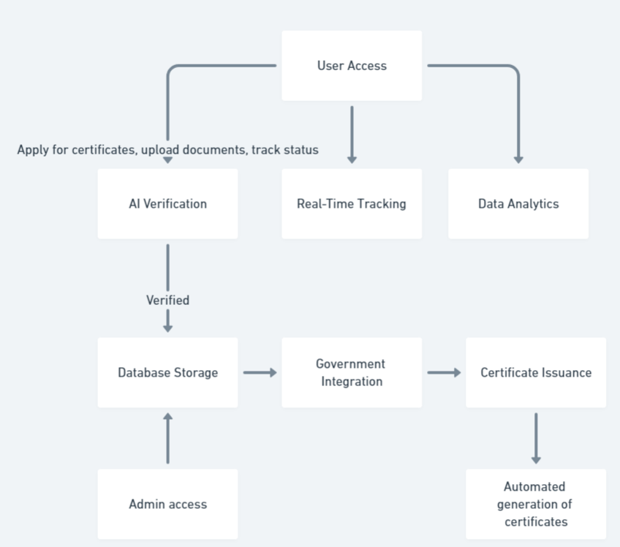
Architecture

Slide 11
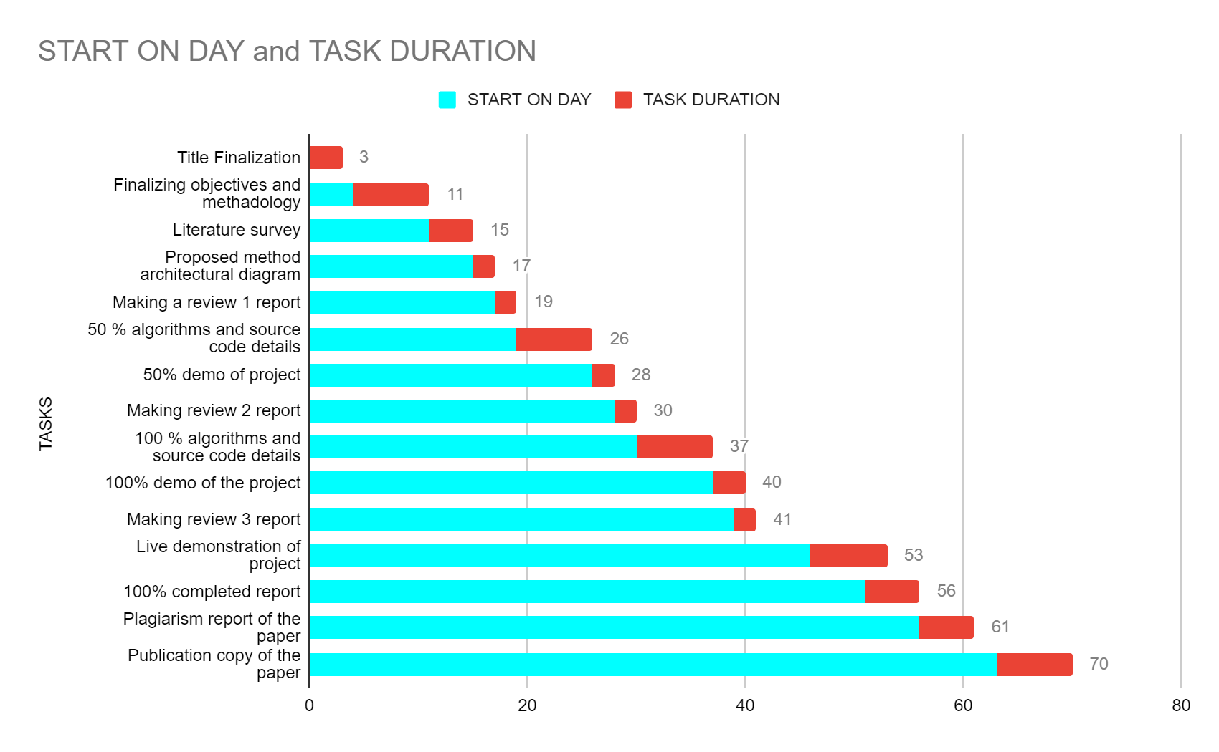
Timeline of Project

Slide 12
Expected Outcomes
Faster Processing : Applications will be processed quickly, leading to prompt certificate issuance.
Higher Accuracy : AI will minimize errors, ensuring that all information on certificates is correct.
Better User Experience: An intuitive online platform will make it easier for users to apply for certificates.
Real-Time Application Tracking: Users can monitor the status of their applications, enhancing transparency.
Enhanced Data Security: Strong security measures will protect personal information, building user trust.
Valuable Data Insights: Analytics will provide insights into birth and death trends, aiding public health initiatives.
Streamlined Compliance : Integration with government databases will ensure regulatory requirements are met.
Increased Public Trust: A transparent and efficient process will encourage more people to use the certification services.

Slide 13
Conclusion
The AI-driven birth/death certification project transforms how we manage vital records, making the process quicker and more accurate. With an easy-to-use interface and real-time tracking, citizens can easily access their certificates, which builds trust in government services.
By aligning with the United Nations Sustainable Development Goals, this project supports public health, reduces inequalities, and strengthens governance. In short, it aims to create a more efficient system that meets today’s needs while promoting a sustainable future.

Slide 14
Github Link
GitHub Link
https://github.com/joelgdaniel/Capstone-Project-birth-death-registration-with-services

Slide 15
References
https://www.nielit.gov.in/chandigarh/content/digitization-death-birth-records
https://unstats.un.org/unsd/demographic-social/crvs/documents/IIVRS_papers/IIVRS_paper26.pdf
Chen, J., et al. (2021). Cloud Computing Security: A Survey of Issues and Solutions. Journal of Cloud Computing.
Fernandez, A., et al. (2023). Enhancing User Experience in Digital Government Services: A Case Study. International Journal of E-Government Research.
Garcia, M., & Martin, L. (2022). Digital Inclusion in Government Services: The Role of AI. Public Administration Review.
Jones, R., & Patel, S. (2023). AI Applications in Public Sector Data Management. Government Information Quarterly.
Kumar, S., et al. (2021). The Pitfalls of Paper-Based Record Keeping. Journal of Administrative Sciences.
Lee, Y., et al. (2022). Natural Language Processing in Administrative Processes. Journal of Information Technology.
Nguyen, T., & Tran, H. (2023). Security Measures in Cloud-Based Government Systems. Cybersecurity Review.
Ravi, P., & Singh, D. (2023). Innovations in Birth and Death Registration in India. Asian Journal of Public Health.
Roberts, K., & Chen, Y. (2023). Ethical Implications of AI in Public Administration. Journal of Ethics in Public Life.
Smith, J. (2020). The Importance of Digital Transformation in Government Records. Public Sector Innovation Journal.

Slide 16

Project work mapping with SDG

Slide 17
Thank You

